Slide 1

City Microclimate and Traffic Analysis
IoT Project 2024-2025
Fyrogeni Ariadne 1083816
Psychogiou Georgia 1083979

Slide 2

BASIC STRUCTURE
Accurate microclimate report and forecast
Study of the correlation between weather conditions and traffic situations
Alerts notifying for traffic complications and severe weather phenomena

Slide 3

Target group
Data for statistic analysis
Data used to alert citizens for problems in extreme weather conditions (floods)
European Union
(TRAN)
Ministry of Infrastructure and Transportation
Infrastructure planning
Ministry of Climate Crisis and Civil Protection
Notifications for traffic issues to modify their route
Municipal Authorities
Urban planning (design streets that mitigate urban heat islands, optimize building configurations and increase green spaces)
Public transport companies
Citizens
Traffic status update
Notes:
Committee on Transport and Tourism (επιτροπή)
Υπουργείο κλιματικής κρίσης και προστασίας του πολίτη
Υπουργείο υποδομών και μεταφορών
Ministry of Infrastructure and Transportation: repair of the points of the roads ? in which traffic-related problems are reported

Slide 4

Final System Architecture
Connector
InfluxDB
Grafana
MQTT broker
Front-end (Website)
Context broker
Lab Sensors
Request API
publish
subscribe
Data Processor
Back-end
http
Data Ingestion
Weather API
Update API
Traffic API
http
Local weather’s systematic differentiations
Localized Forecast
FORTH/ICE-HT Weather Stations
http
Weather API Forecast Data
Traffic API Data
Correlation
Weather Data
Notes:
Data Input:
Sensors publish real-time data to the MQTT broker.---- ΙΕΤ/ΙΕΧΜΗ
Weather and traffic APIs fetch complementary data.
Data Processing:
Subscriber processes MQTT messages and stores them in InfluxDB.
Data from APIs are stored in InfluxDB as well.
Data Analysis:
API data is localized by comparing it with sensor data.
Perform statistical analysis (e.g., correlation) using Python.
Data Output:
Serve data to the web dashboard.
Visualize heatmaps and graphs.
Report warnings.

Slide 5
DATA PROCESSING
Connector
InfluxDB
Grafana
MQTT broker
Front-end (Website)
Context broker
Lab Sensors
Request API
publish
subscribe
Data Processor
Back-end
http
Data Ingestion
Weather API
Update API
Traffic API
CLOUD
http
FORTH/ICE-HT Weather Stations
http
VIRTUAL GATEWAY
Notes:
Data Input:
Sensors publish real-time data to the MQTT broker.---- ΙΕΤ/ΙΕΧΜΗ
Weather and traffic APIs fetch complementary data.
Data Processing:
Subscriber processes MQTT messages and stores them in InfluxDB.
Data from APIs are stored in InfluxDB as well.
Data Analysis:
API data is localized by comparing it with sensor data.
Perform statistical analysis (e.g., correlation) using Python.
Data Output:
Serve data to the web dashboard.
Visualize heatmaps and graphs.
Report warnings.

Slide 6
operations
User’s location selection by:
Clicking on the map marker
Clicking on the location from a list of buttons
Choosing from the dropdown button
Typing the point name in the search bar
General overview of Patras Weather, accurate microclimate demonstration of current data and forecasts by combining meteorological data from open APIs with real local weather data from sensors and weather stations.
Current traffic conditions in each location indicated by the traffic percentage. Prediction of the above metric by a forecasting method that utilizes last week’s data.
UI visualization of graphs indicating the progression of traffic versus key microclimate parameters’ alternations and the differentiations of these parameters from one location to another.
Calculation of the correlation index between traffic data and rain amount for specific points of interest.
Alerts and warning reports concerning slippery roundabouts caused by severe rainfall, dangerously windy bridges, road closures due to flood and extremely high temperatures.

Slide 7
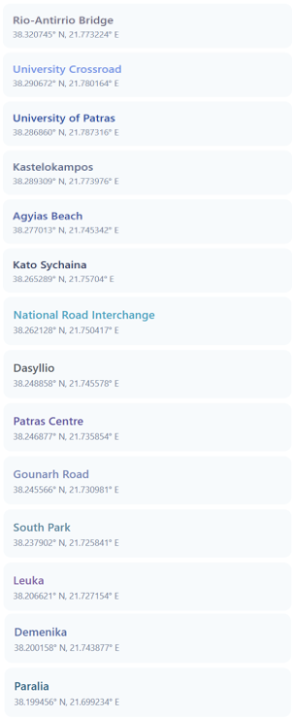
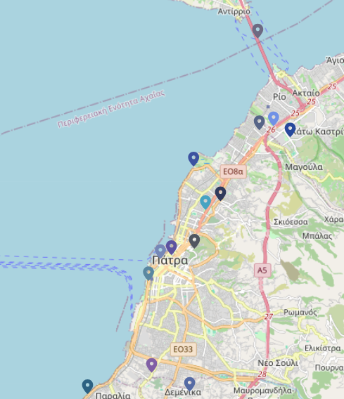
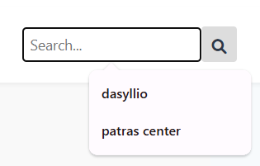
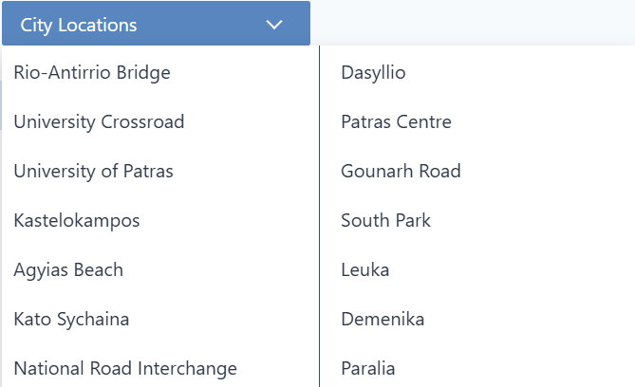
Clicking on the location from a list of buttons:
Typing the point name in the search bar:
Clicking on the map marker:
Choosing from the dropdown button:
LAB SENSOR
FORTH/ICE-HT WEATHER STATION
OPENWEATHER API

Slide 8
operations
User’s location selection by:
Clicking on the map marker
Clicking on the location from a list of buttons
Choosing from the dropdown button
Typing the point name in the search bar
General overview of Patras Weather, accurate microclimate demonstration of current data and forecasts by combining meteorological data from open APIs with real local weather data from sensors and weather stations.
Current traffic conditions in each location indicated by the traffic percentage. Prediction of the above metric by a forecasting method that utilizes last week’s data.
UI visualization of graphs indicating the progression of traffic versus key microclimate parameters’ alternations and the differentiations of these parameters from one location to another.
Calculation of the correlation index between traffic data and rain amount for specific points of interest.
Alerts and warning reports concerning slippery roundabouts caused by severe rainfall, dangerously windy bridges, road closures due to flood and extremely high temperatures.

Slide 9
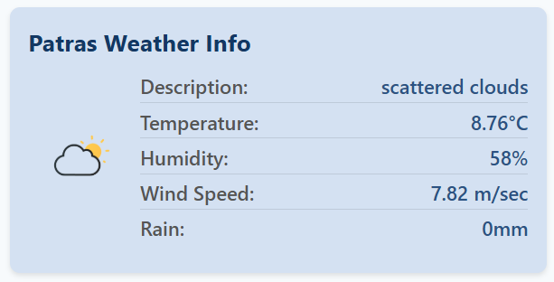
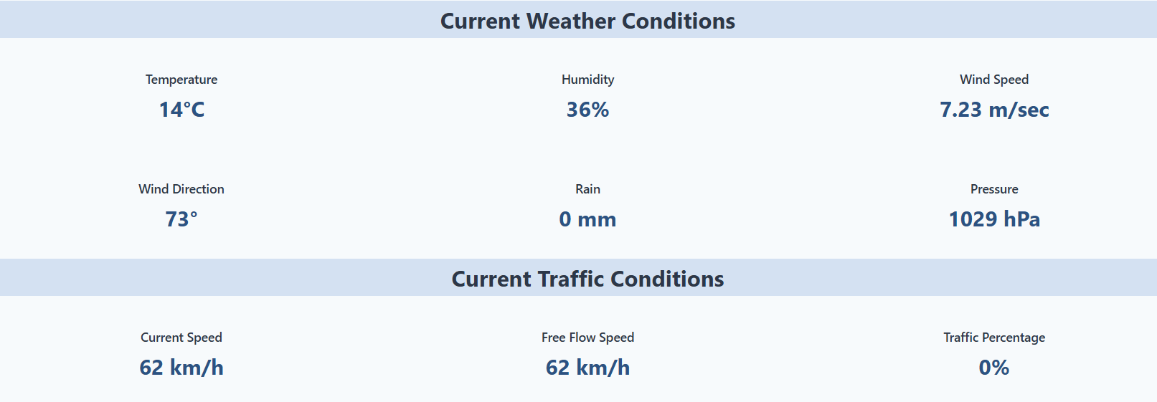
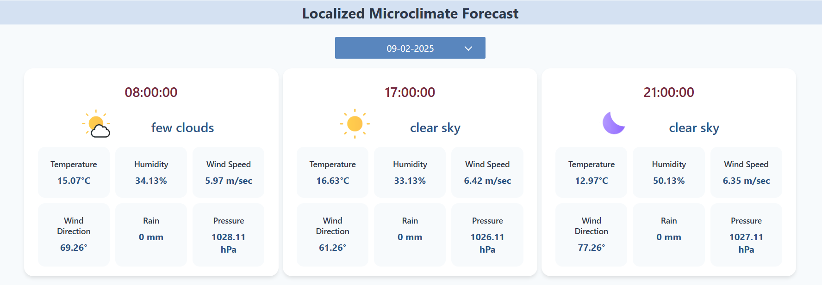
General overview of Patras Weather:
Accurate microclimate demonstration of current data:
Localized weather predictions for the next 3 days:

Slide 10

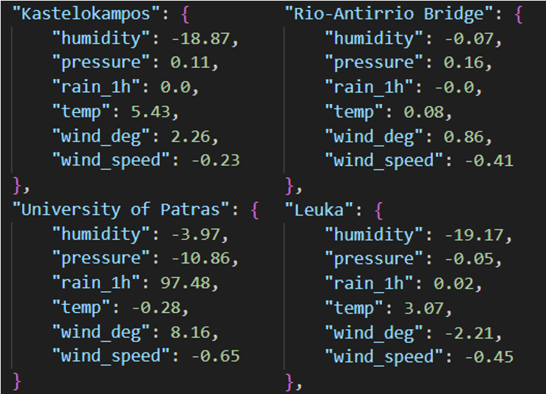
Localization of weather FORECAST
CORRECTION
Systematic differences are stored and modify regional data
3rd party API
Regional weather data for Patras
Local weather forecast with microclimate accurate corrections
Local weather stations and sensors
Microclimate data
3rd party API
Regional weather forecast for Patras

Slide 11
operations
User’s location selection by:
Clicking on the map marker
Clicking on the location from a list of buttons
Choosing from the dropdown button
Typing the point name in the search bar
General overview of Patras Weather, accurate microclimate demonstration of current data and forecasts by combining meteorological data from open APIs with real local weather data from sensors and weather stations.
Current traffic conditions in each location indicated by the traffic percentage. Prediction of the above metric by a forecasting method that utilizes last week’s data.
UI visualization of graphs indicating the progression of traffic versus key microclimate parameters’ alternations and the differentiations of these parameters from one location to another.
Calculation of the correlation index between traffic data and rain amount for specific points of interest.
Alerts and warning reports concerning slippery roundabouts caused by severe rainfall, dangerously windy bridges, road closures due to flood and extremely high temperatures.

Slide 12

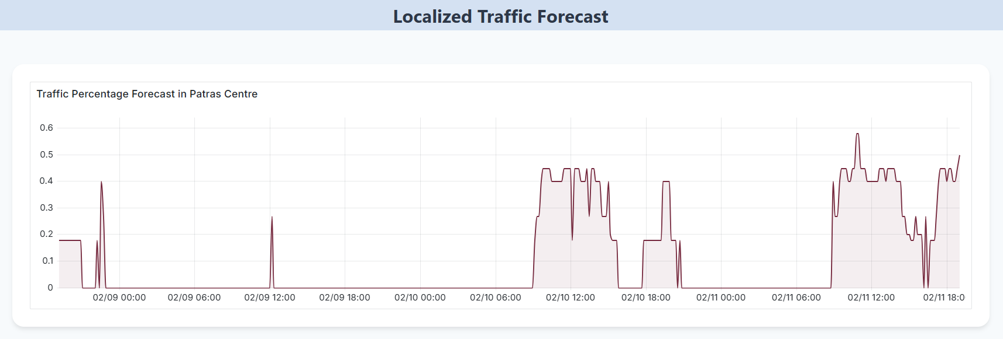

Current traffic percentage in each location:
Localized traffic predictions for the next 3 days:

Slide 13
operations
User’s location selection by:
Clicking on the map marker
Clicking on the location from a list of buttons
Choosing from the dropdown button
Typing the point name in the search bar
General overview of Patras Weather, accurate microclimate demonstration of current data and forecasts by combining meteorological data from open APIs with real local weather data from sensors and weather stations.
Current traffic conditions in each location indicated by the traffic percentage. Prediction of the above metric by a forecasting method that utilizes last week’s data.
UI visualization of graphs indicating the progression of traffic versus key microclimate parameters’ alternations and the differentiations of these parameters from one location to another.
Calculation of the correlation index between traffic data and rain amount for specific points of interest.
Alerts and warning reports concerning slippery roundabouts caused by severe rainfall, dangerously windy bridges, road closures due to flood and extremely high temperatures.

Slide 14
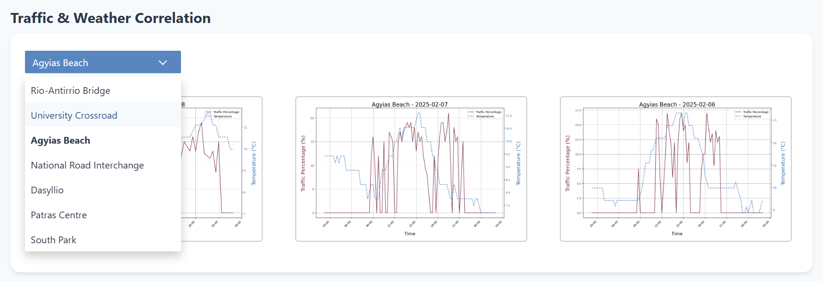
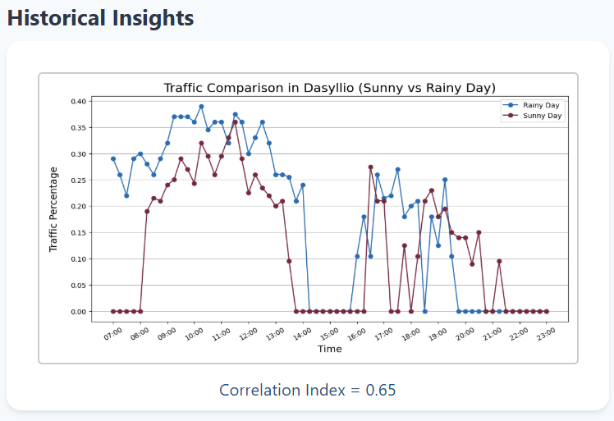
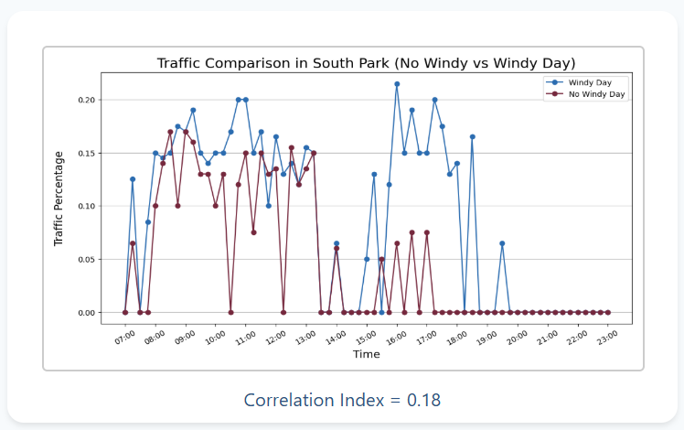
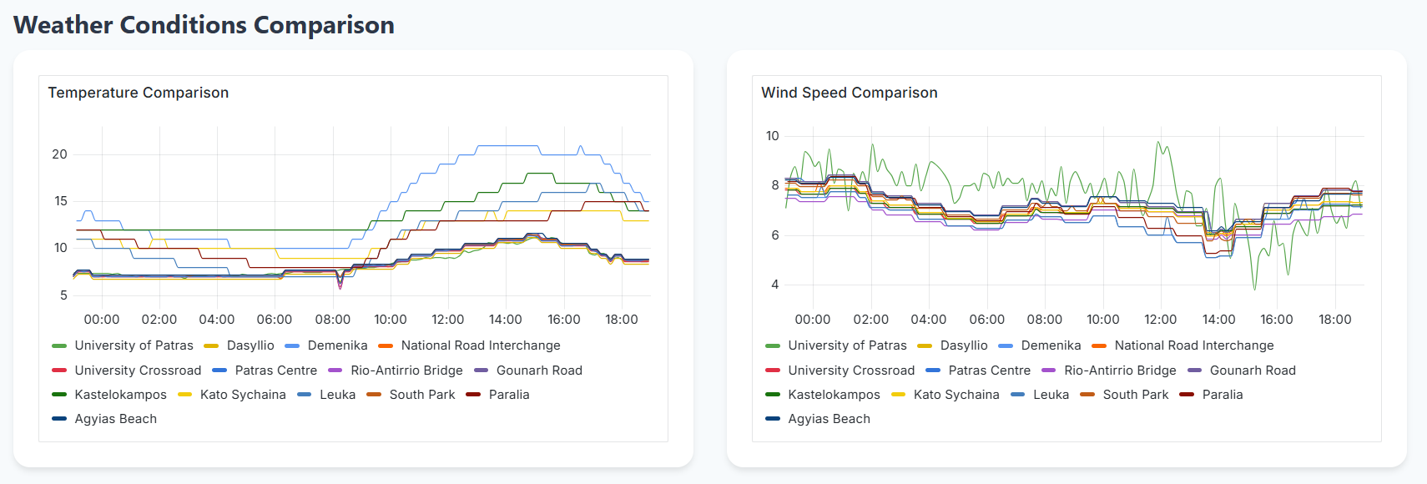
Progression of traffic versus key weather parameters’ alternations:
Correlation index between traffic data and weather metrics (Pearson Method):
Differentiations of microclimate parameters from one location to another:

Slide 15
operations
User’s location selection by:
Clicking on the map marker
Clicking on the location from a list of buttons
Choosing from the dropdown button
Typing the point name in the search bar
General overview of Patras Weather, accurate microclimate demonstration of current data and forecasts by combining meteorological data from open APIs with real local weather data from sensors and weather stations.
Current traffic conditions in each location indicated by the traffic percentage. Prediction of the above metric by a forecasting method that utilizes last week’s data.
UI visualization of graphs indicating the progression of traffic versus key microclimate parameters’ alternations and the differentiations of these parameters from one location to another.
Calculation of the correlation index between traffic data and rain amount for specific points of interest.
Alerts and warning reports concerning slippery roundabouts caused by severe rainfall, dangerously windy bridges, road closures due to flood and extremely high temperatures.

Slide 16
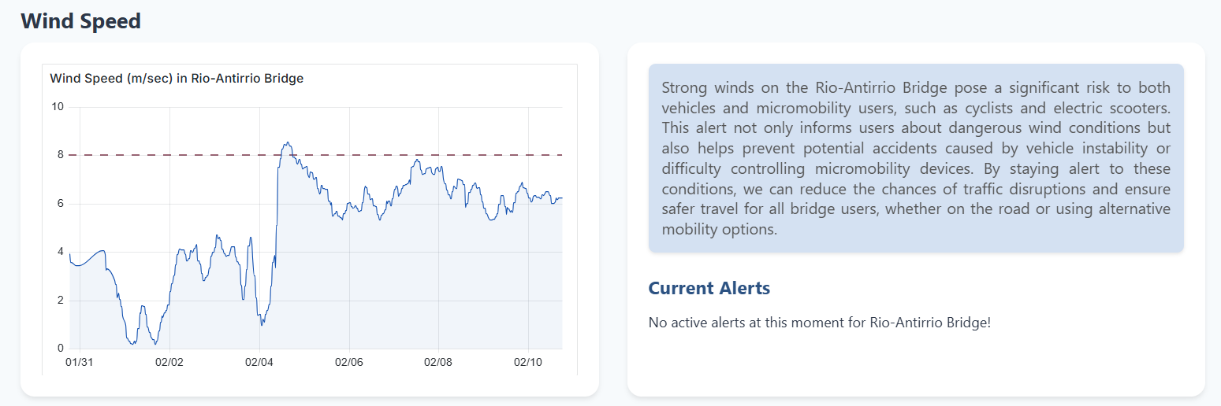
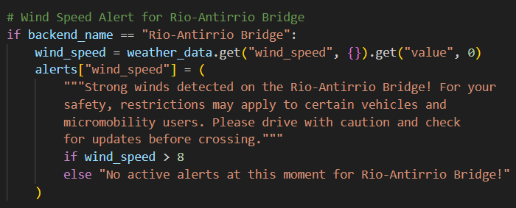
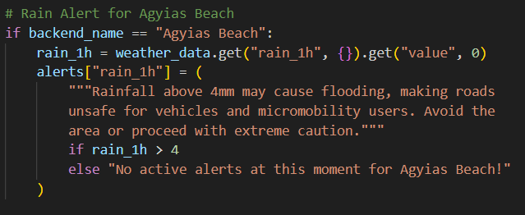
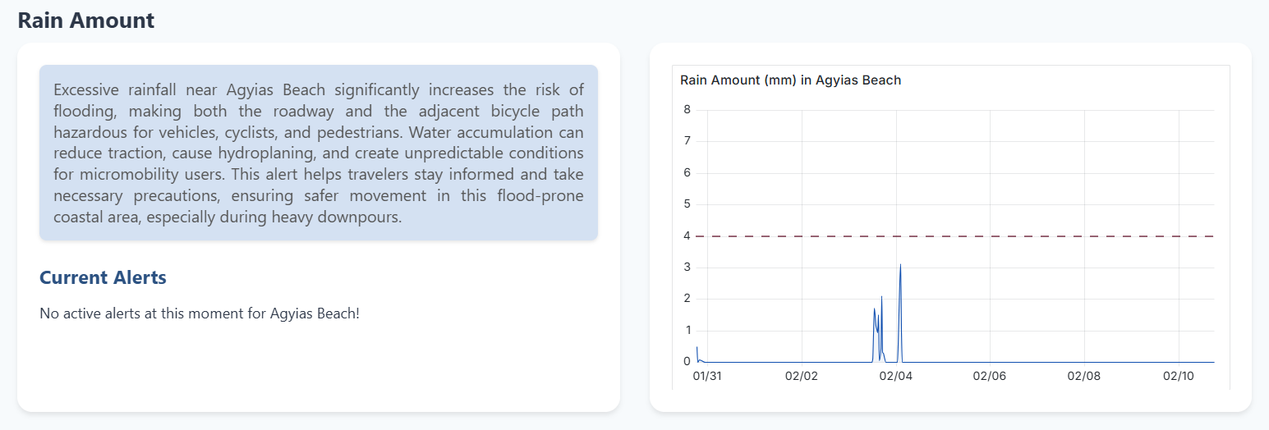

Slide 17

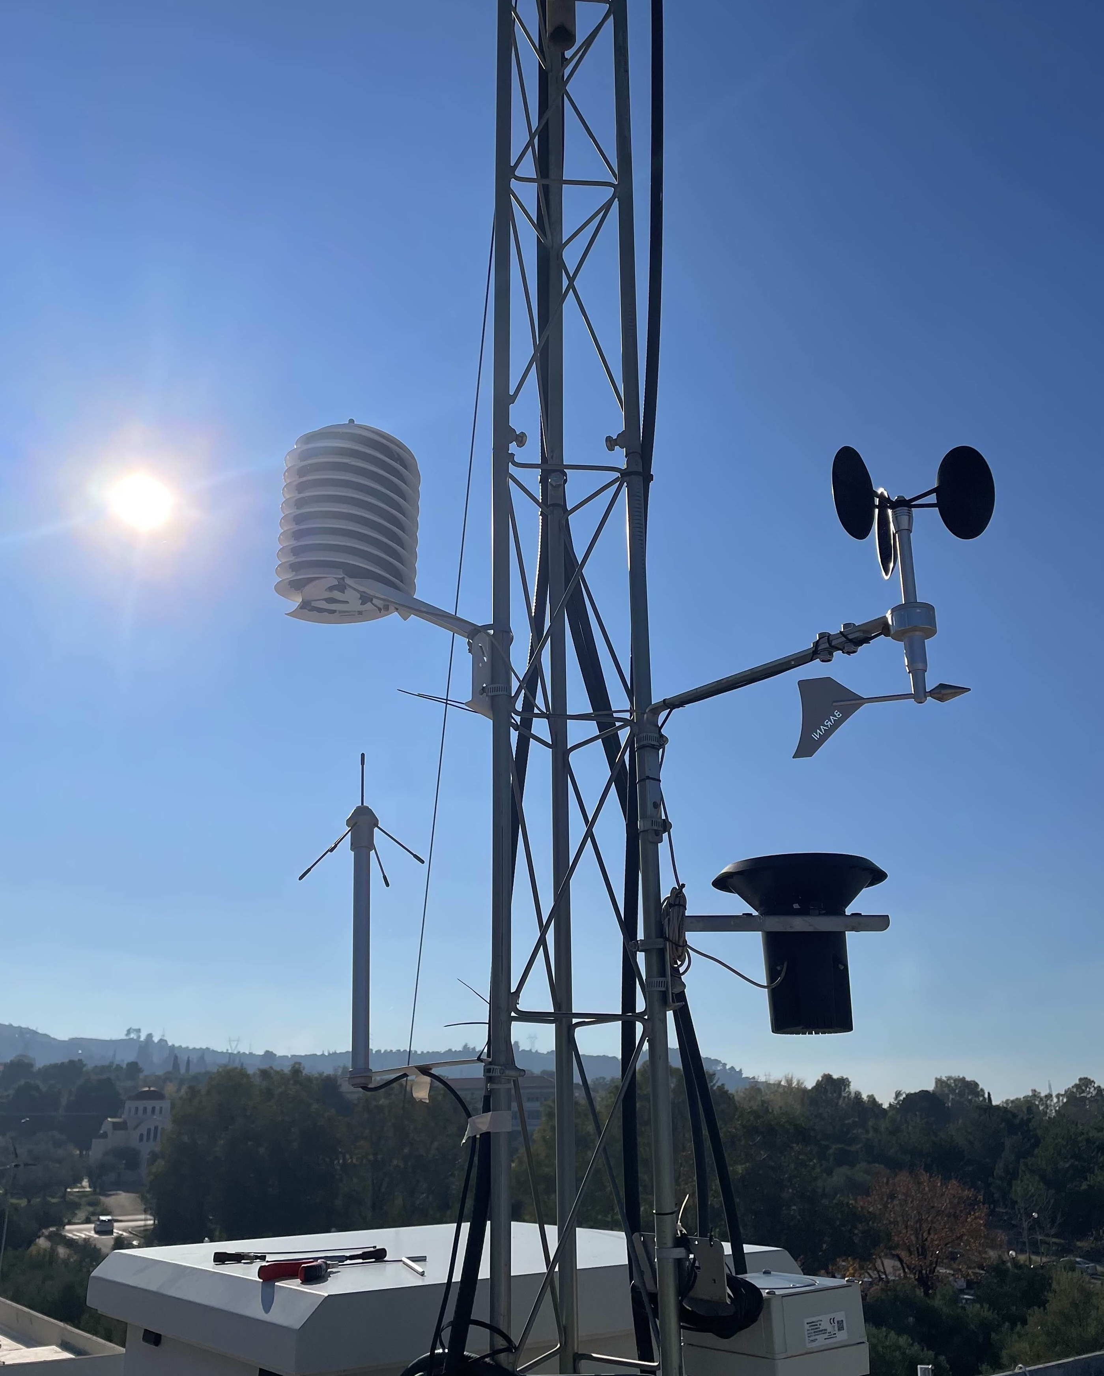
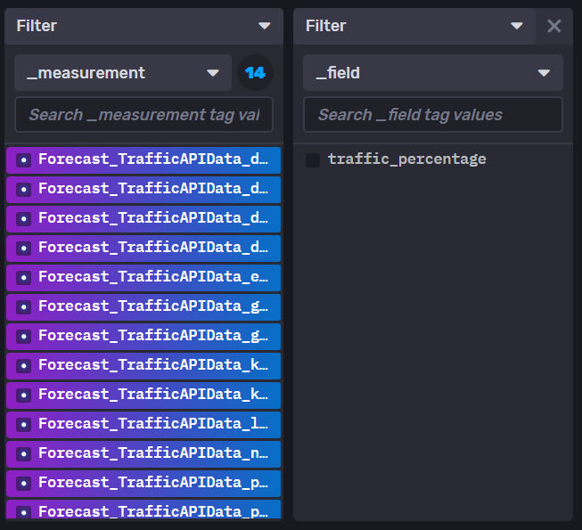
challenges
MeteoHelix and MeteoWind IoT Pro lab’s sensors adjustment for more accurate wind direction and irradiation measurements.
Measurement values conversion into one single total of measurement units for all the different sources of weather data.
+ RAIN
Traffic percentage prediction diagram through Grafana, using last week’s data as the forecast method.

Slide 18
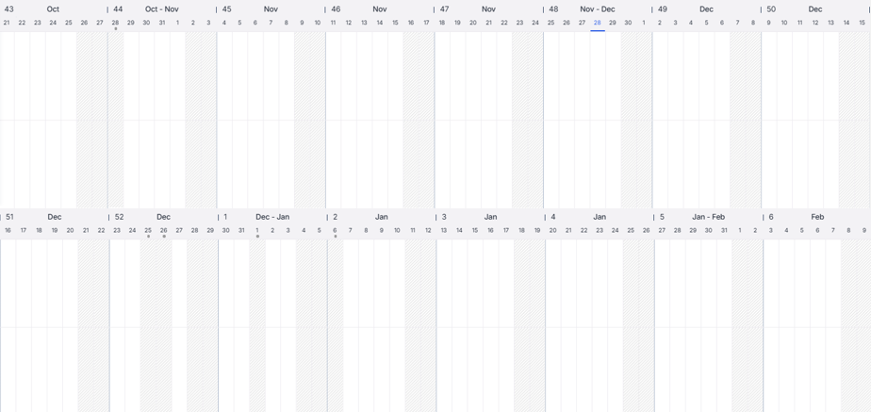
final Work distribution
Georgia Psychogiou
Ariadne Fyrogeni
Configuration of the project idea
System Architecture study
Sensors and APIs’ data management
Virtual Gateway (weather APIs)
Syntax of 1st presentation
Syntax of 2nd presentation
Virtual Gateway (traffic API, sensors)
Basic Backend (current data and correlation)
Data processing (forecast, final diagrams)
Data processing (alerts, Grafana diagrams)
Final modifications of website composition
Syntax of 3rd presentation
Frontend (initial version and connection with backend)

Slide 19
THANK YOU!
Any questions?

